Slide 1

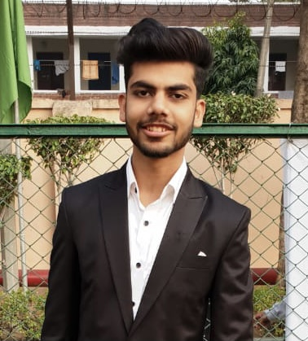
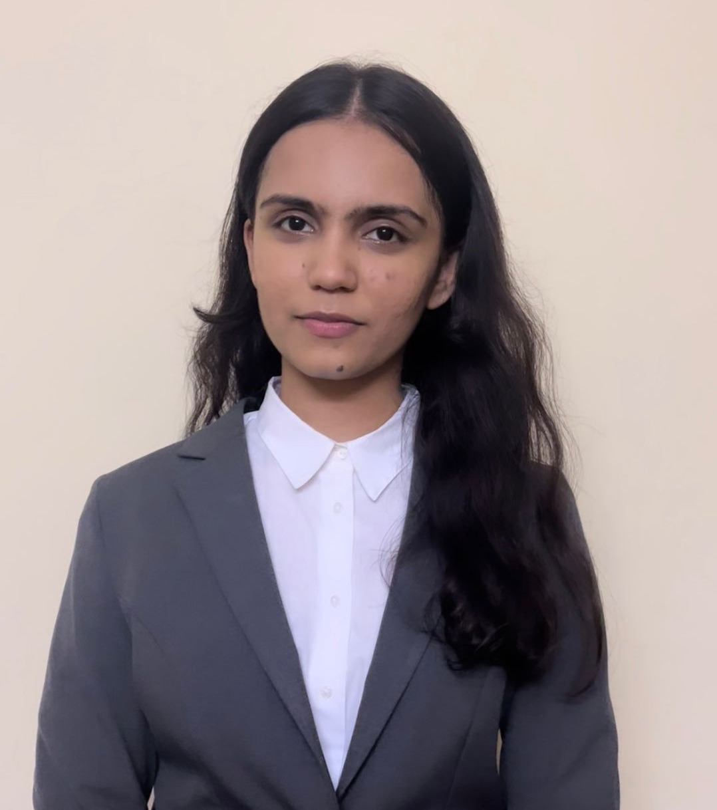
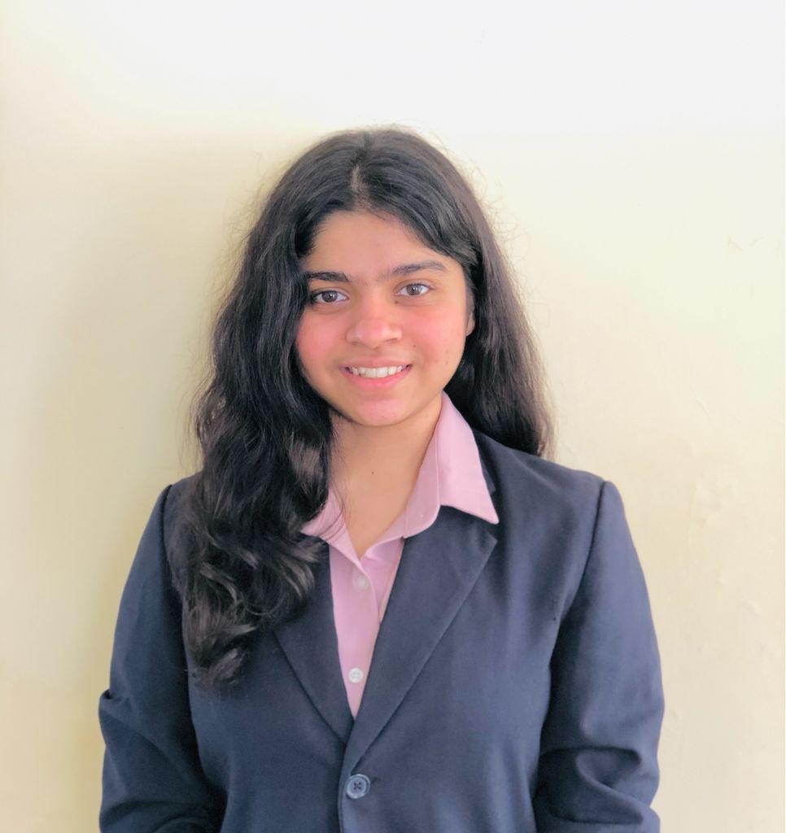
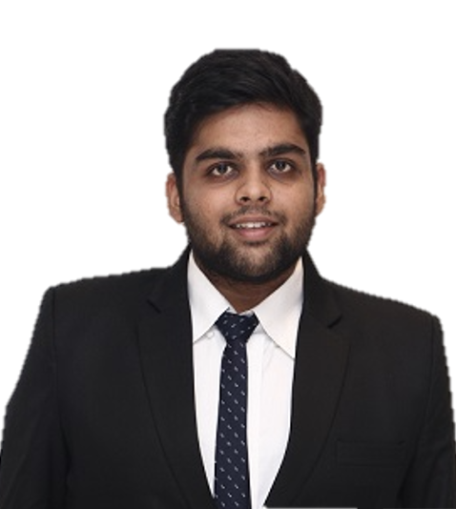
E-Commerce Strategy
- Designing Digital Strategy for a Home Textiles Brand
Team Aspirants
Archit Kapoor
Deeksha Verma
Procurement Lead
Marketing Lead
Hensi Sheth
Sanyam Gupta
Digital Lead
Supply Chain Lead

Slide 2
Addressable Ecommerce Market Size
Addressable Ecommerce Market
Segmentation & Cluster Analysis
Competitor Benchmarking
Channel Strategy & Portfolio Strategy
Digital Marketing Mix
Campaigns & Feasibility Analysis
Total Addressable Market (By Category)
Supermarkets & Hypermarkets
Bedsheets
45%
$0.22 Bn
Home Textile Market Size
7%
Online
15%
Towels
$7 Bn
$0.49 Bn
20%
$0.075 Bn
Speciality Stores
Top of Bed
TAM
$ 0.49Bn
$0.10 Bn
SAM
$ 0.31Bn
Serviceable Addressable Market
Serviceable Obtainable Market
SOM
$ 0.05Bn
Total Addressable Market
$0.49 Bn
Current Share of ABC = 10%
(leading home textile player)
22%
40%
38%
Potential increase in share = 5%
(campaigns and ideal portfolio mix)
Tier 1/ Metro
Tier 2
Tier 3
Assumptions:
Current share of ABC is 10% as it is a leading player
People are willing to switch between brands and there is scope to gain market share
Only targeting tier 1 and 2 cities and ignoring tier 3
$0.11 Bn
$0.20 Bn
$0.18 Bn
SAM = 0.11 + 0.20 = 0.31 Bn
SOM = 0.15*0.31 = 0.05 Bn
Source: EMIS Reports, Textile Ministry

Slide 3
Addressable Ecommerce Market Size
Addressable Ecommerce Market
Segmentation & Cluster Analysis
Competitor Benchmarking
Channel Strategy & Portfolio Strategy
Digital Marketing Mix
Campaigns & Feasibility Analysis
Total Addressable Market (By Category)
Supermarkets & Hypermarkets
Bedsheets
45%
$0.22 Bn
Home Textile Market Size
7%
Online
15%
Towels
$7 Bn
$0.49 Bn
20%
$0.075 Bn
Speciality Stores
Top of Bed
TAM
$ 0.49Bn
$0.10 Bn
SAM
$ 0.31Bn
Serviceable Addressable Market
Serviceable Obtainable Market
SOM
$ 0.05Bn
Total Addressable Market
$0.49 Bn
Current Share of ABC = 10%
(leading home textile player)
22%
40%
38%
Potential increase in share = 5%
(campaigns and ideal portfolio mix)
Tier 1/ Metro
Tier 2
Tier 3
Assumptions:
Current share of ABC is 10% as it is a leading player
People are willing to switch between brands and there is scope to gain market share
Only targeting tier 1 and 2 cities and ignoring tier 3
$0.11 Bn
$0.20 Bn
$0.18 Bn
SAM = 0.11 + 0.20 = 0.31 Bn
SOM = 0.15*0.31 = 0.05 Bn
Source: EMIS Reports, Textile Ministry

Slide 4







Addressable Ecommerce Market
Segmentation & Cluster Analysis
Competitor Benchmarking
Channel Strategy & Portfolio Strategy
Digital Marketing Mix
Campaigns & Feasibility Analysis
Income based segmentation
Cluster Analysis for Segmentation
Target market
Priority
Towels
Bedsheets
5 point agreement scale
Cluster 1
Product focused
Middle aged (25-50 yr), Tier 1&2 cities
Sustainability conscious
Awareness regarding finishes
High willingness to pay
Priority
 | 1 | 2 | 3
Lacks_Time | 4.15 | 2.65 | 2.00
Lacks_Knowledge | 3.02 | 3.90 | 3.07
Ecofriendly_Finishes | 3.80 | 2.71 | 1.93
Designs | 3.78 | 3.90 | 1.64
Wellness_Hygiene | 3.22 | 4.03 | 3.21
Durability | 3.64 | 2.30 | 1.92
Cost_Saving | 3.00 | 3.68 | 4.21
Age | 3.69 | 4.10 | 4.29
Functional benefits | 2.31 | 3.61 | 4.14
Brand_Conscious | 3.20 | 3.79 | 2.21
Trend_conscious | 2.15 | 3.81 | 3.30
Mid price
Premium
Mid price
Premium
Low
price
Cluster 2
Explorers
Leisure shoppers, Tier 1 cities
Young (20-30 yrs.)
Tech-Savvy early adopters
Limited disposable income
*Weighted avg of prod portfolio across segments on 3 platforms
Cluster 3
Bargain Hunters
Cost conscious, Tier 2 cities
Durability and fabric of product
Medium disposable income
Not brand conscious
Geographic presence
Current | Proposed
Metro cities | Tier 1 & 2 cities
Expert talks & secondary research
Consumer Life-Cycle (Micro Analysis)
Awareness
Acquisition
Conversion
Retention
Telephonic discussion with 8 interior designers, from Gujarat across tier-I,II cities. Research report on home textiles market on Euromonitor, CRISIL on e-commerce
Inertia, less brand awareness Sustainability, Unorganized market | Reluctance to commit on online platforms, less reviews on e-commerce platforms | High bargaining power of buyers, less brand conscious, variety of options available
Brand awareness & educate, Identify and activate triggers | Testimonials, blogs, featured on credible pages for trust | Tracking and redeeming customers
Bacteria free bedding, Influencer marketing, Bundle pricing, | Video marketing, Discounts, coupons, e-commerce catalogues | Rewards programme, old towel exchange campaign
Gap
Customer Interviews & Survey
Need
In-depth interviews of 7 homeowners, 5 on rentals & assisted online survey of 100 people
tier-I, II, III cities; age: 25 to 50.
Solution

Slide 5






Addressable Ecommerce Market
Segmentation & Cluster Analysis
Competitor Benchmarking
Channel Strategy & Portfolio Strategy
Digital Marketing Mix
Campaigns & Feasibility Analysis
High
Low
Bed Linen
Price
High
Category of Products | Bed Linen, Bath Linen, Flooring | Bed Linen, Bath Linen | Bed Linen, Bath Linen | Bed Linen, Bath Linen, Flooring, Others | Bed Linen, Bath Linen, Flooring
Consumer Needs | Essential | Luxury, Essential, Design, Gifting | Essential, Design, Gifting | Luxury, Design, Gifting | Grey area
Price Segment
Willingness to act sustainably
Quality
Low
Bath Linen
Price
Softness
Value Based pricing across all the segments
Penetration in market that is not brand loyal
Differentiated play
Promotional campaigns focused on increasing revenue from Amazon, Flipkart
Others*
Price
Price
Place
Promotion
Products
Widening the marketing funnel to increase brand awareness, desire to transact & purchase intent
Super soft, quick dryer, anti microbial towels. High quality designs matching any decor
Design

Slide 6



Having an omni-platform presence will facilitate high growth
Addressable Ecommerce Market
Segmentation & Cluster Analysis
Competitor Benchmarking
Channel Strategy & Portfolio Strategy
Digital Marketing Mix
Campaigns & Feasibility Analysis
Comparative favourability of platforms
Unfavourable
Favourable
Having and Omni-Channel platform presence will enable: 1) Access to larger TAM 2) Reduce threat due to single provider 3) Match accessibility with competitors
Market Size
Online experience store
Commission Cost
Envelopment Threat
Category Relevance
Favourable | Favourable | Factoring in growth rate (Exhibit 3) | Bedsheet | Towel | Top of bed
Amazon | 70% |  | 34% | 41% | 39%
Flipkart | 58% |  | 25% | 21% | 23%
Myntra | 66% |  | 41% | 38% | 37%
*Upper range of growth rate in exhibit 3 is considered for calculations

Slide 7




ABC needs to widen its marketing funnel, follow a holistic digital strategy
Addressable Ecommerce Market
Segmentation & Cluster Analysis
Competitor Benchmarking
Channel Strategy & Portfolio Strategy
Digital Marketing Mix
Campaigns & Feasibility Analysis
Customer Journey
Online SEO
Home textiles is a high involvement buying industry
Offline SEO
Awareness
Instagram Ads
Video Ads
Search
Platform
Compare
Decision
Consideration
Copymining
Advertorials
Strategy Actions
Achievable Target
KPIs To Track
Purchase
Own Website
Run effective SEO
Track metrics effectively
CTR
Brand Authority
Occasion Marketing
Promotional Campaigns
E-Commerce Affiliate
Website & Blogs
Easy to Manage
Bounce Rate
Traffic Rate
Personalized Emails
E-Commerce PPC
Widen Consideration Set
High Visibility
Bounce Rate
CPS
ABC company needs to increase its internet presence to increase penetration and gain a larger market share
CLV
Influencer Marketing
Video Collaterals
Content Creation
ROAS
CPA

Slide 8

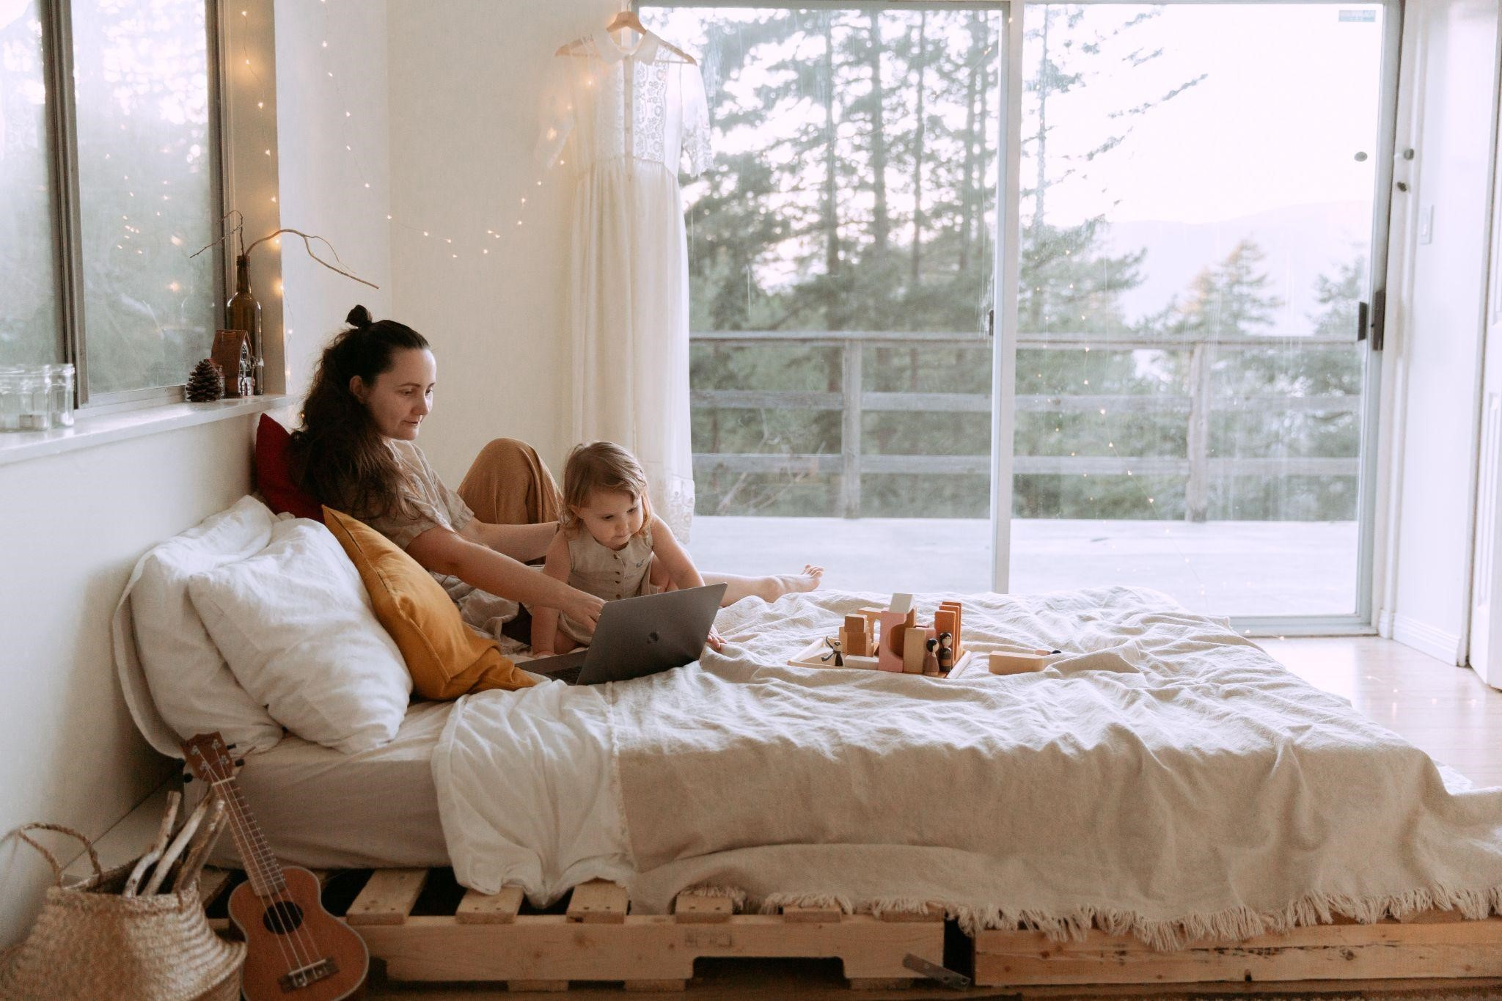
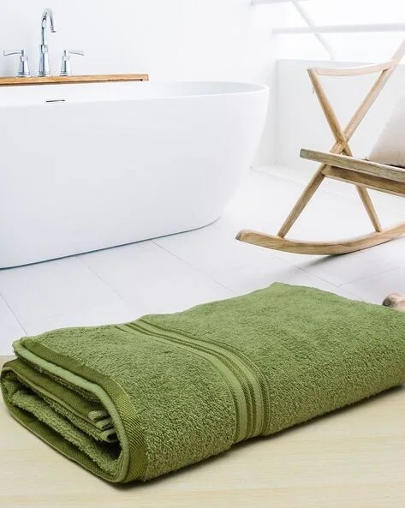

Addressable Ecommerce Market
Segmentation & Cluster Analysis
Competitor Benchmarking
Channel Strategy & Portfolio Strategy
Digital Marketing Mix
Campaigns & Feasibility Analysis
“ Naya Saaz, Naya Rishta”
#GoGreenWithABC
#AbHarGharABC
What festivals mean to engaged Customers?
Our customers are becoming environment conscious by the day
Tier 2 penetration of organized home textile brands is less due to less brand conscious consumers
Concept: Run campaigns like “This Diwali, Make a change” to telling everyone to say no to crackers and showing the family spreading a new air purifying bedsheets and comforters in a home filled with Diyas
Concept: We aim to run social media campaigns with the hashtag #GoGreenWithABC to engage our customers on social media. With this, we will provide our customers discount coupons if they return their used towels & bedsheets
Concept: Pioneering the Hostess Group Demonstrations in order to tap into the power of women’s social networks for personalized demonstrations of bed and bath linen products.
Rationale: Traditionally, festivals meant spending time & enjoying with friends, neighbors & family so associating ABC with festivals would garner positive sentiment around the brand
Rationale: We have long seen this trend that customers usually don't dispose off their old towels & bedsheets. We plan to receive these back from customers in order to recycle the same.
Rationale: Expanding reach and building trust in Tier 2 cities is a little tricky in India. Here, we are empowering women to become independent ABC dealers.
Feasibility Analysis
Cost factor | Unit cost | Conversion Rate | Cost in Year 1 (INR) | Cost in Year 2 (INR) | Cost in Year 3 (INR)
Website maintenance | - | - | 1,50,000 | 70,000 | 70,000
Paid search | Cost per click = Rs.6 | 2.50% | 36,00,000 | 36,00,000 | 36,00,000
Paid social | Avg engagement ratio = 5% | 5% | 30,00,000 | 31,50,000 | 33,07,500
Affiliates | Cost per sale = 8% |  | 3,40,000 | 3,40,000 | 3,40,000
Direct reach | Cost per E-mail= INR 0.0425 | 1.50% | 42,500 | 43,775 | 45,088
Total cost |  |  | 71,32,500 | 72,03,775 | 73,62,588

